Slide 1

WELCOME TO:
General Meeting
6 PM Tuesday, November 27th, 2018
Broun Hall, Room 125

Slide 2

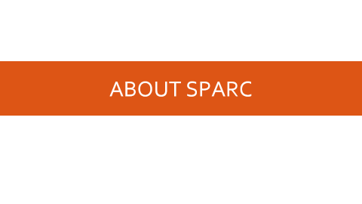
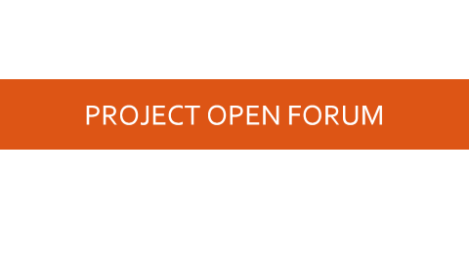
AGENDA

Slide 3
ABOUT SPARC

Slide 4
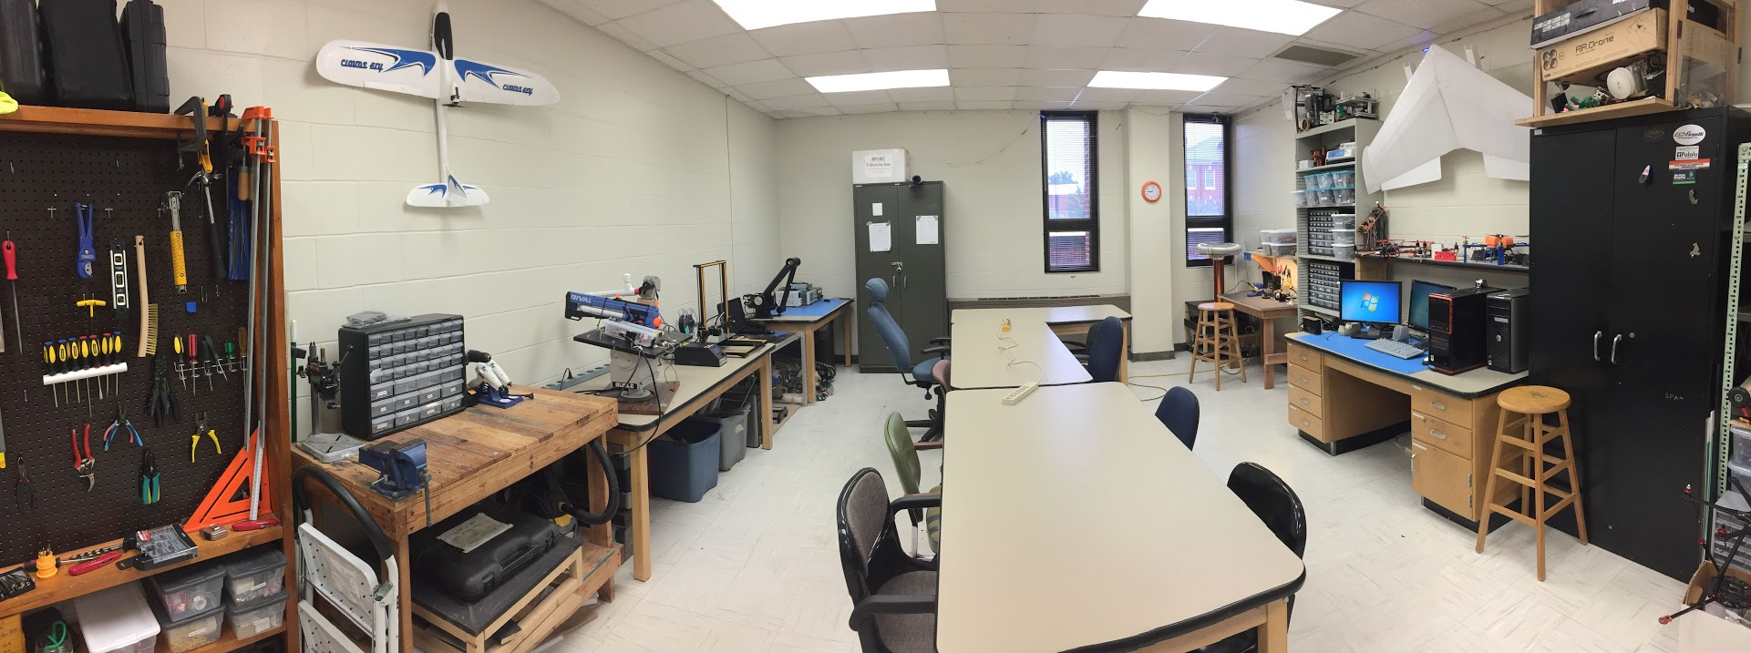
ABOUT SPARC
Creates and fosters an environment of creativity and innovation through collaborative projects.
A place to test out ideas, integrate concepts learned in class, and learn skills that will be instrumental when working in the workforce.
No prior experience is required, only a willingness to learn.
Lab:
- Broun 367
General Meetings:
- Tuesdays @ 6 in Broun 125
Project Meetings:
- Various Times during week

Slide 5
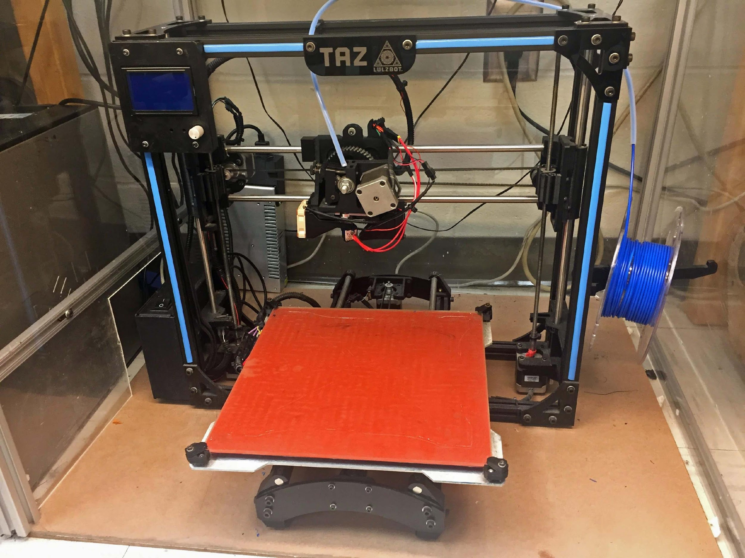
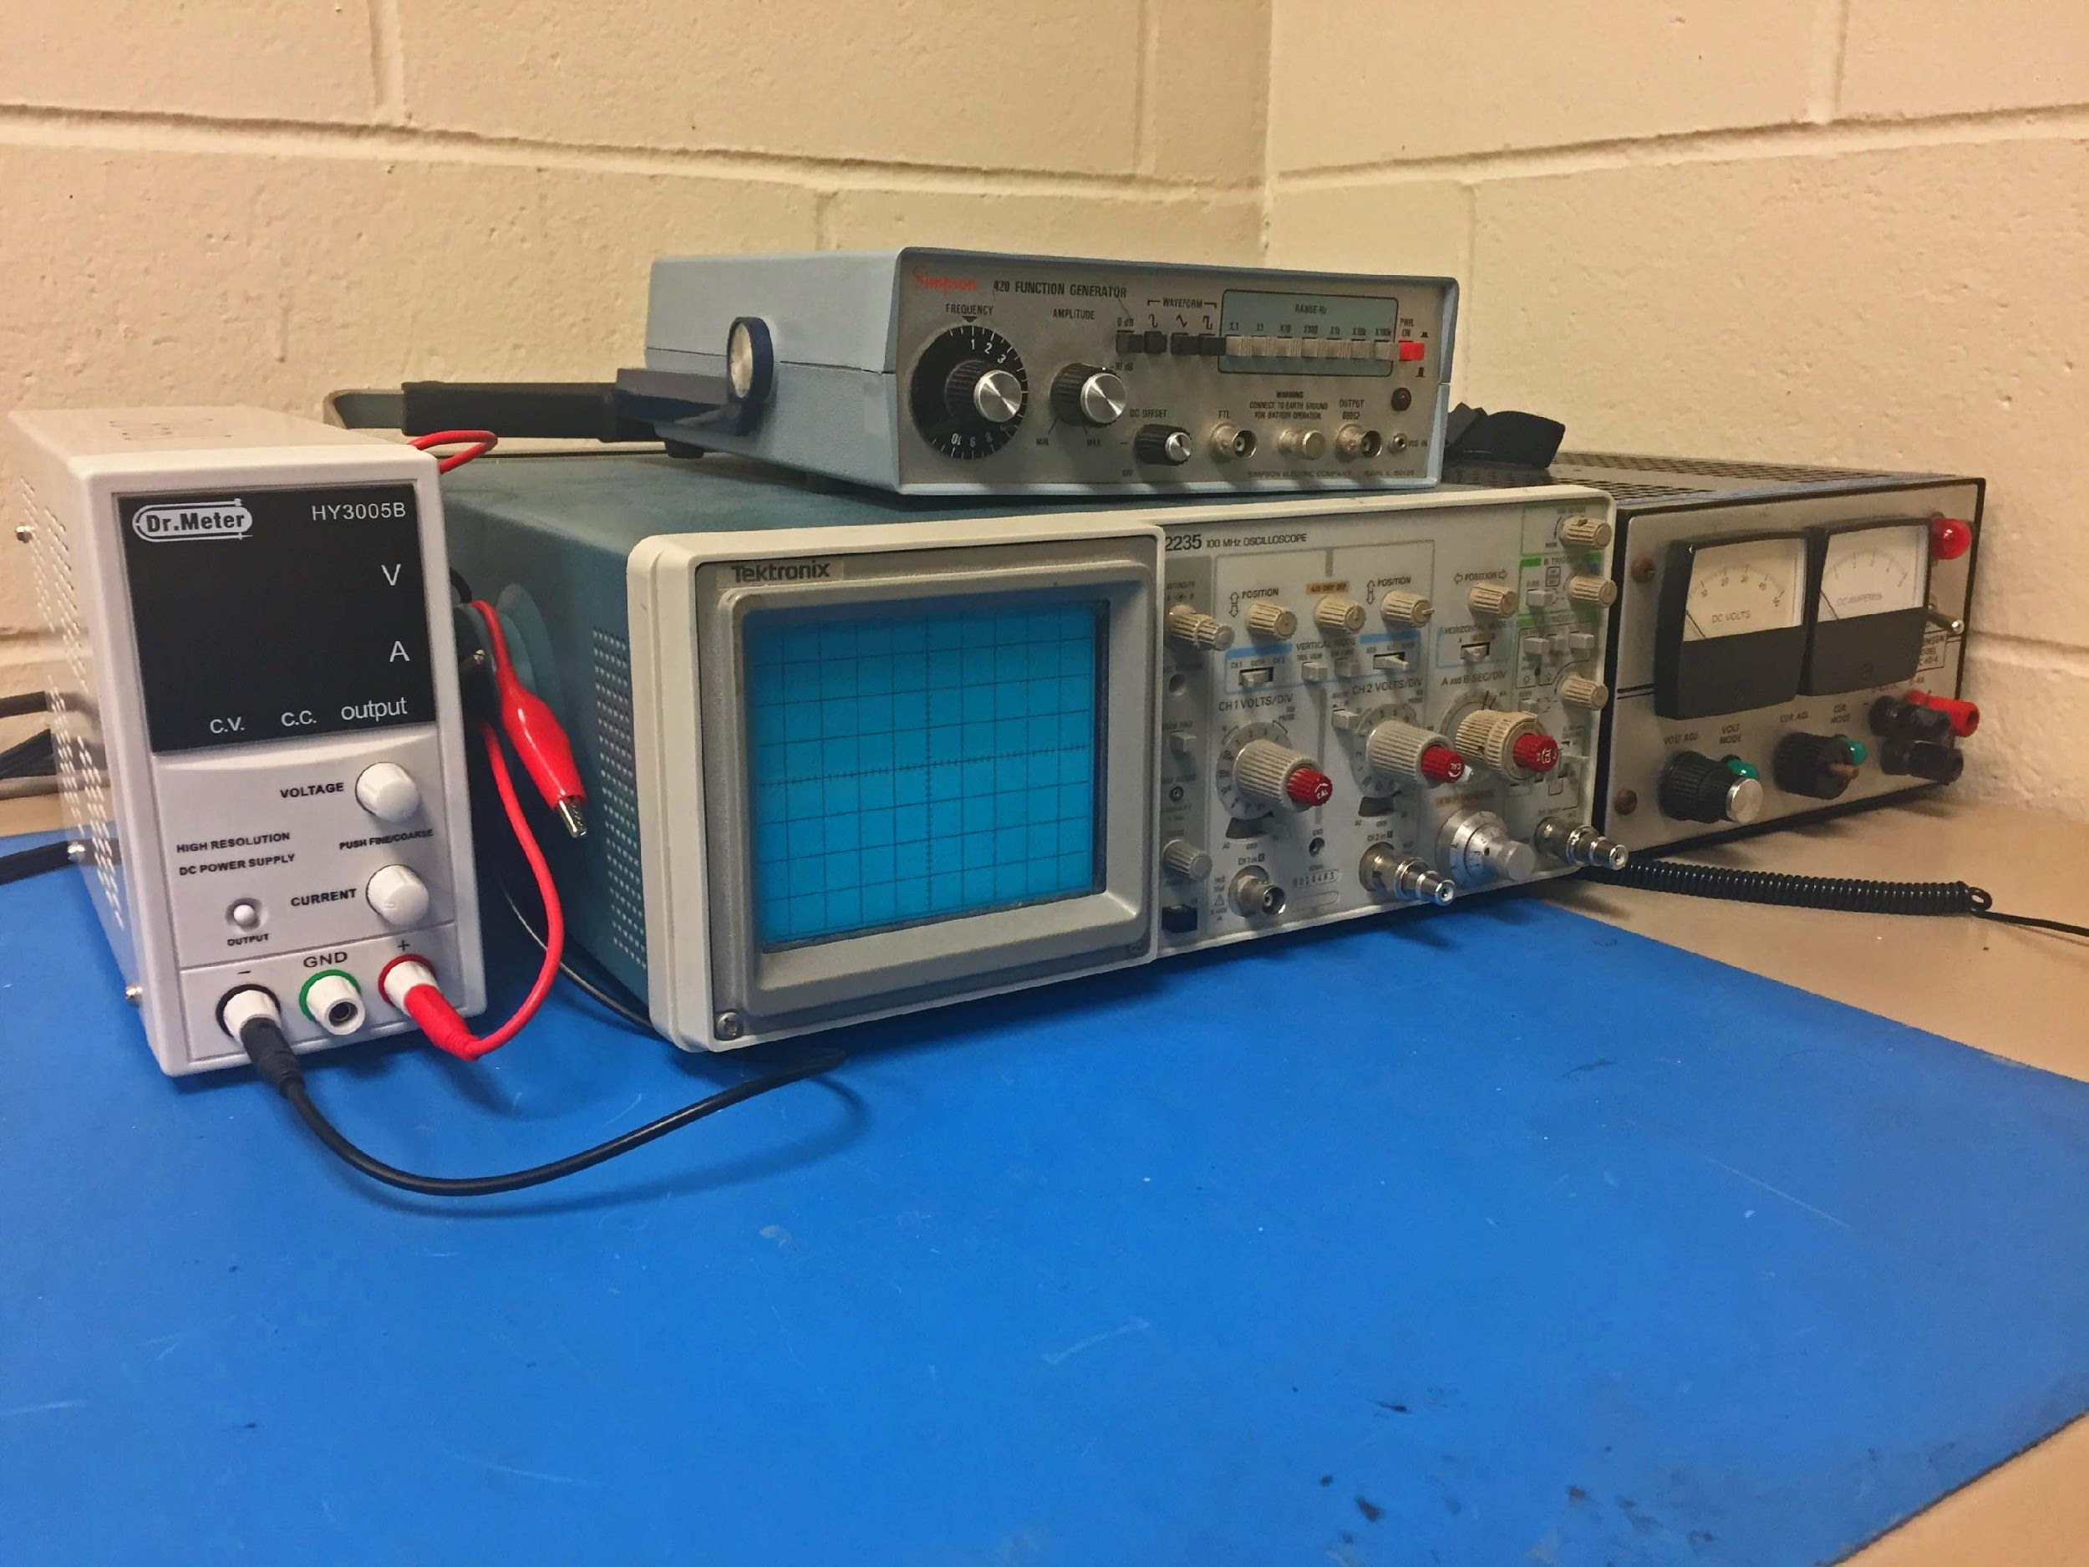
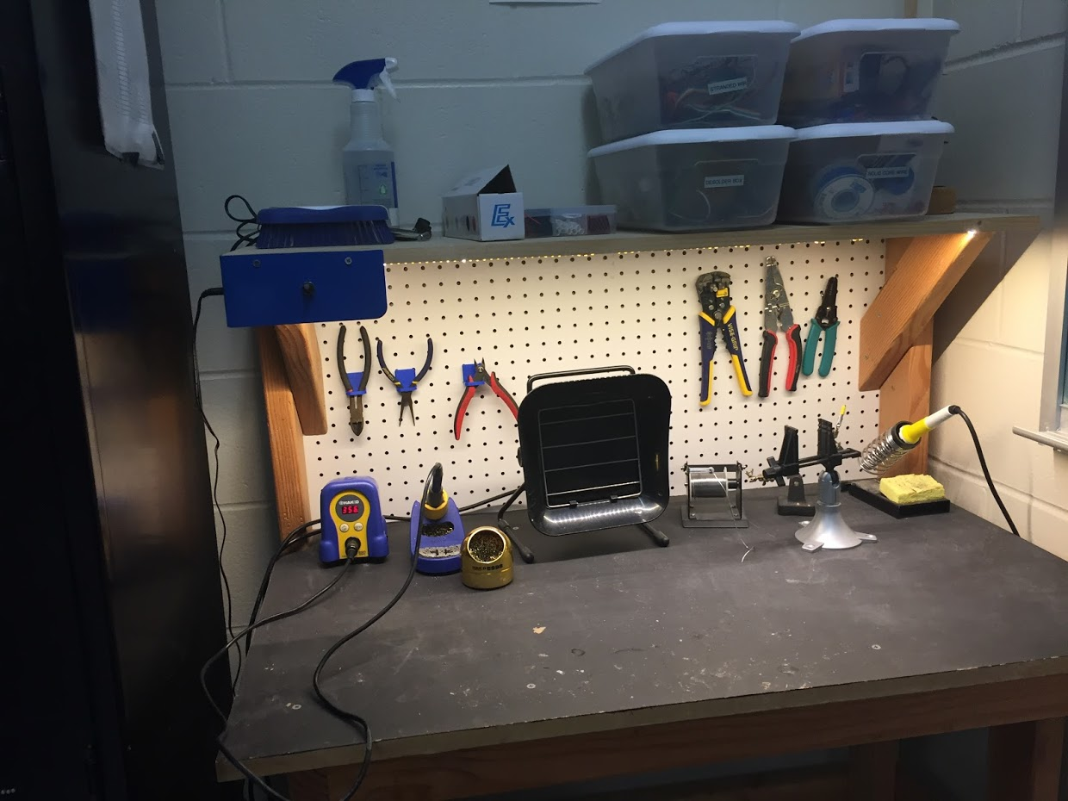
OUR LAB
Broun Hall
Room 367

Slide 6
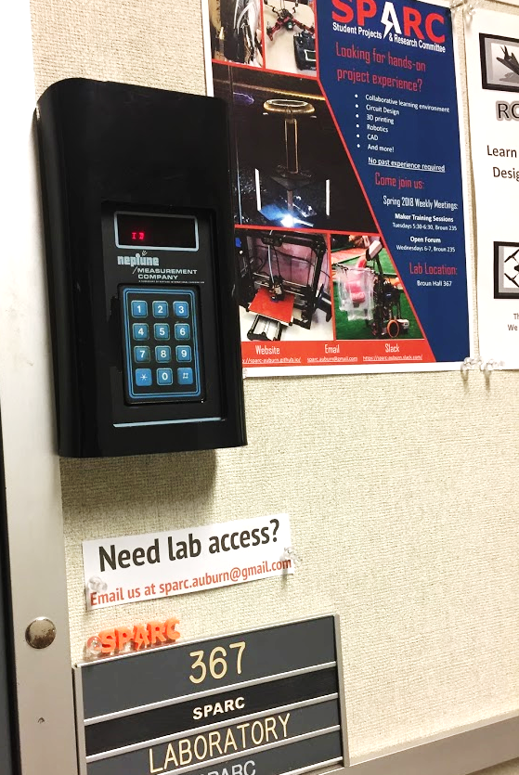
HOW TO BECOME A MEMBER
Log 5 constructive hours in the lab
Write the times on the sheet on the clipboard next to the door.
Contact us at sparc.auburn@gmail.com
We will respond with the instructions to get an access code.

Slide 7




MORE INFORMATION ABOUT SPARC
Website
http://sparc.eng.auburn.edu/
Github
https://github.com/SPARC-Auburn
Slack
https://sparc-auburn.slack.com/
Email
sparc.auburn@gmail.com

Slide 8
QUESTIONS?
Notes:
6:10

Slide 9
Spring 2018 Officers
President:
Alex Jones
Vice President:
Matthew Castleberry
Director of Lab Operations:
Fowler Askew
Director of Public Relations:
Noah Niedzwiecki
Director of Projects:
Rice Shelley

Slide 10
OUTREACH AND RECRUITMENT

Slide 11
UPCOMING EVENTS
Early County High School Visit
Friday, November 30th
1:15pm – 1:45pm
Spain Park HS Visit
Monday, December 3rd
8:45am – 10am
General Notes
We need to tidy up the lab a little bit for the visits
Tours will be similar to potential student tours but slightly longer

Slide 12
PROJECT OPEN FORUM

Slide 13
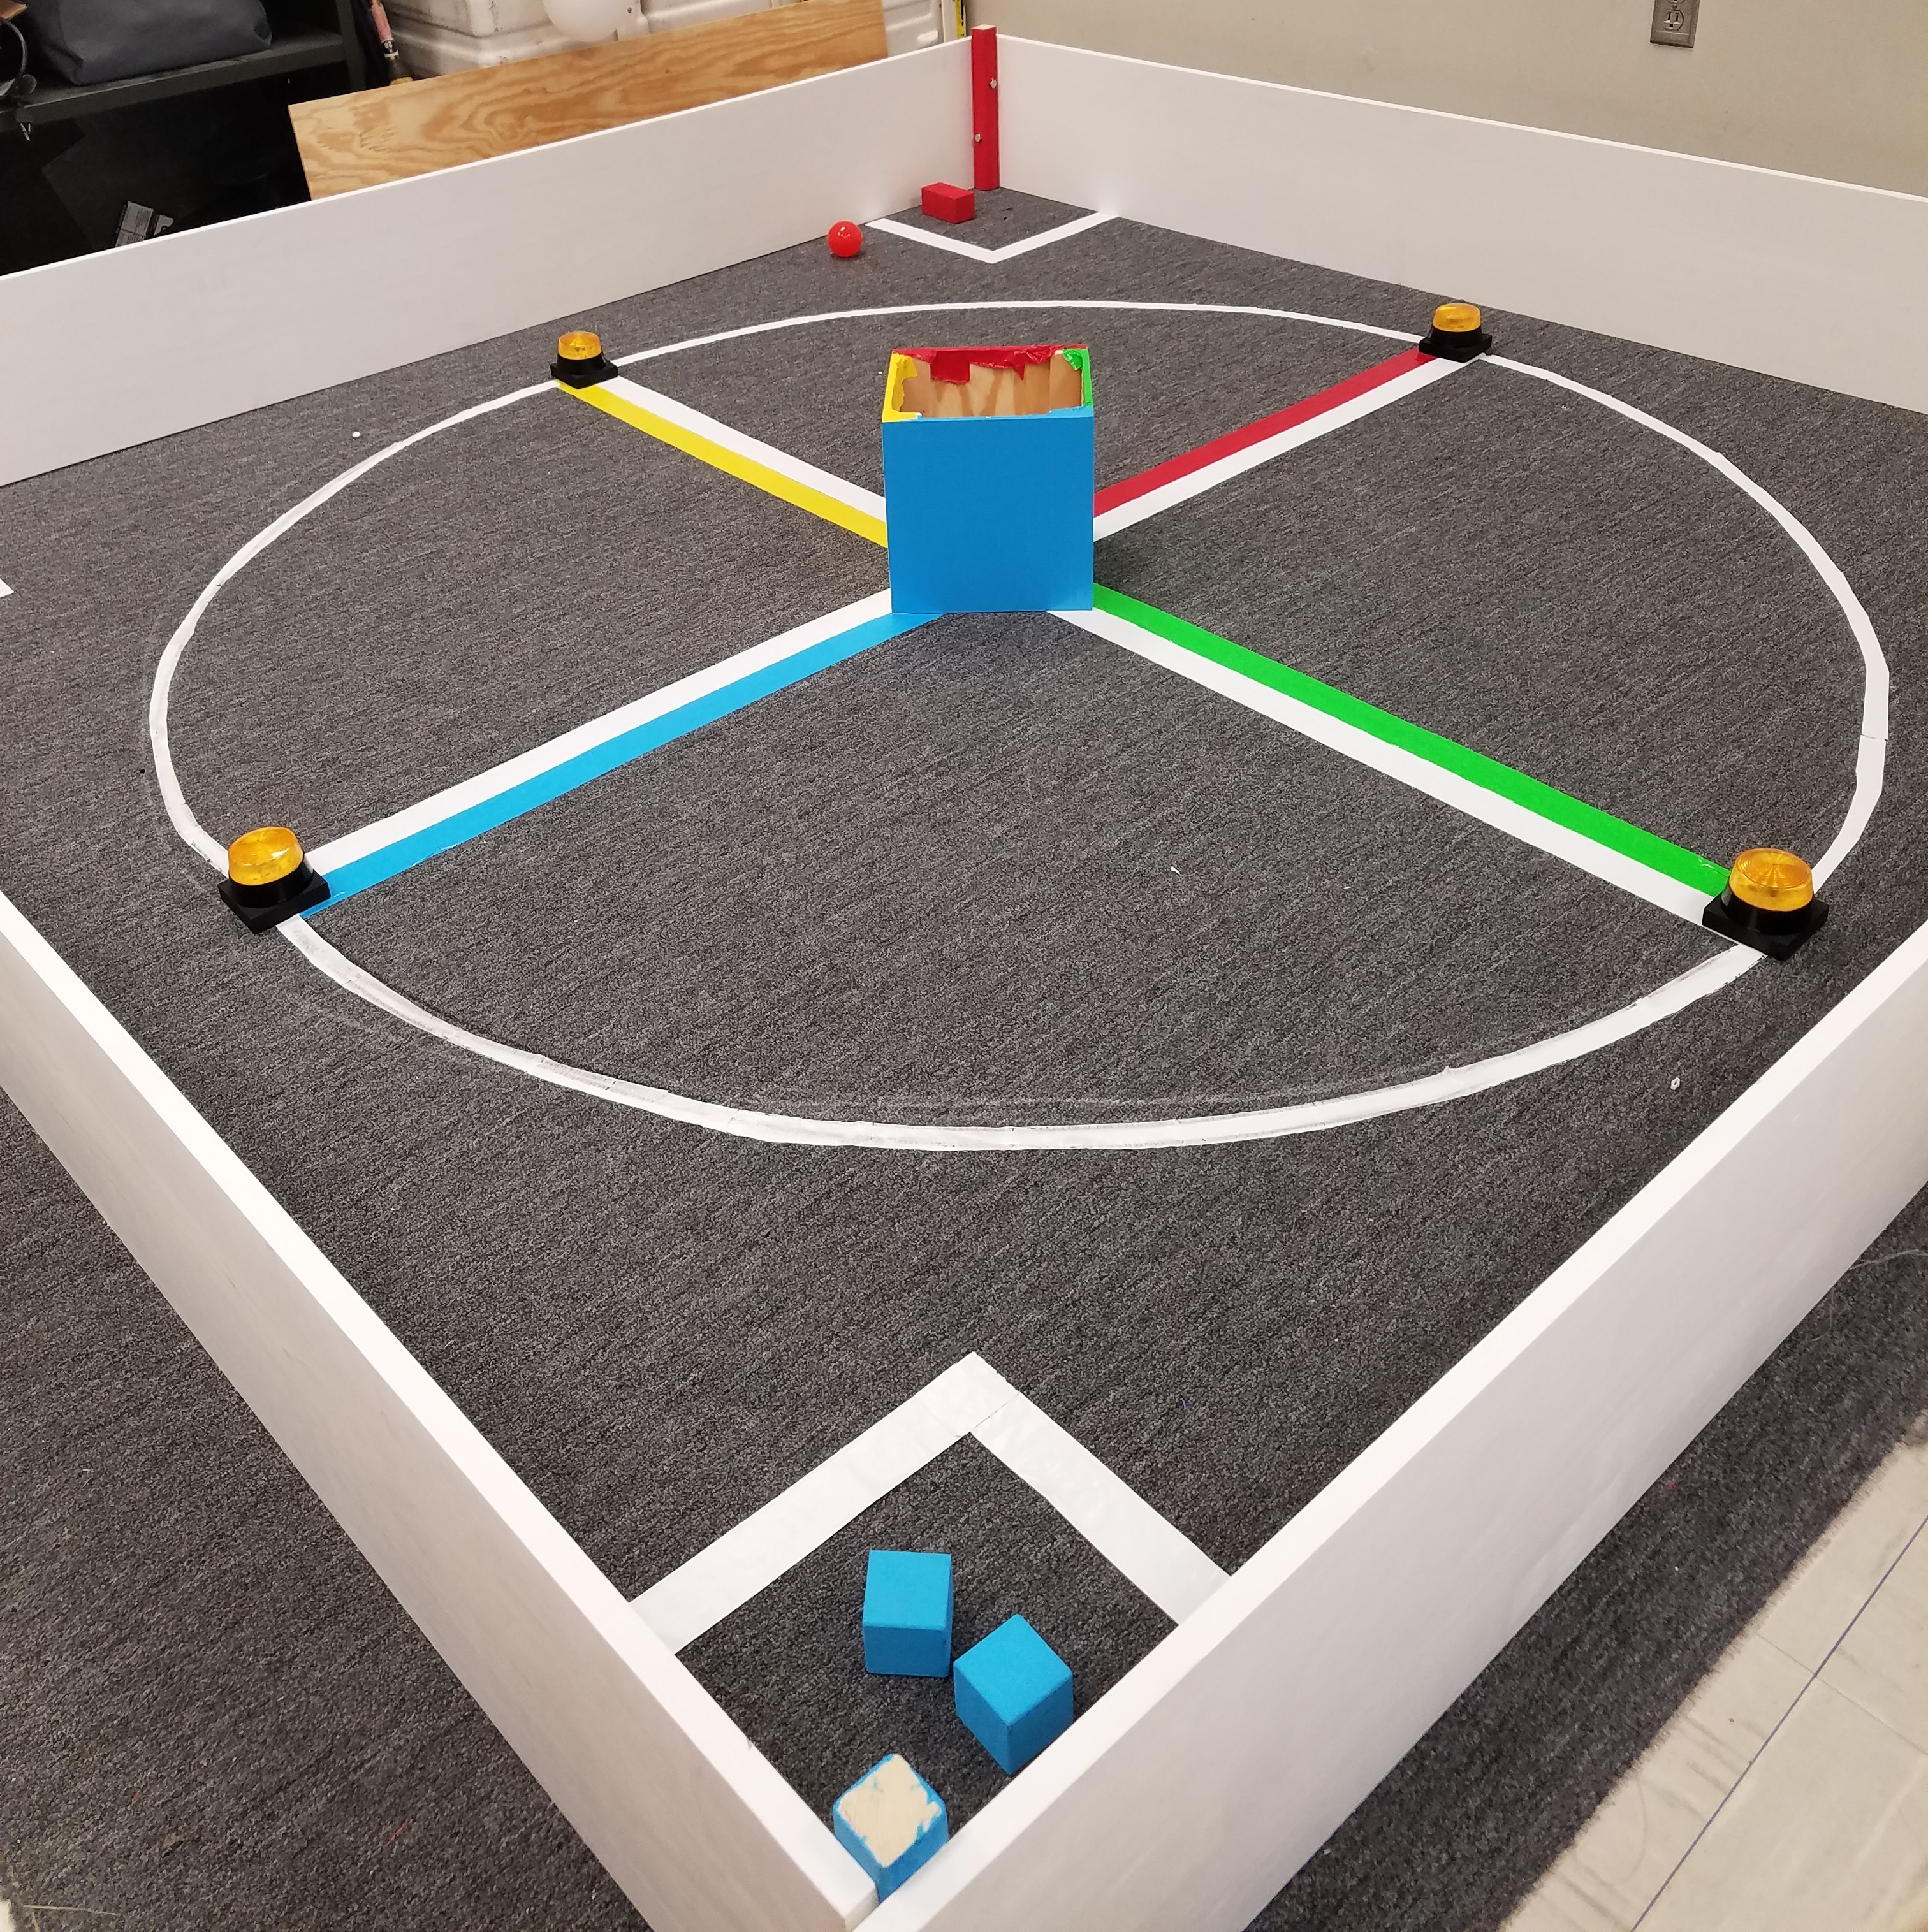
MAJOR PROJECT: IEEE SOUTHEAST CON
Project lead: Matthew Castleberry
Electrical lead: Josh Jablonowski
Mechanical lead: Alex Jones
Slack Channel: #projectieeeelectrical
Slack Channel: #projectieeemechanical
Competition Details:
Build a “space debris” collecting robot
Goal is to collect wood blocks and ball pit balls and deposit them on the side of a small flat ~100” square arena autonomously.
Max dimensions: 9” x 9” x 11”
When and Where:
Thursday, April 11th, 2019 through Sunday, April 14th, 2019.
IEEE Southeastcon conference in Huntsville, AL
Meeting Times
Electrical/Software Meeting: Tuesdays 12:30 - 2
Mechanical Meeting: Mondays 3:30 – 5
Programming Languages: C++,C
Gitlab: ask team lead for access

Slide 14
Status Updates
Mechanical
Recently Completed
3D design
Selection of motors
Parts ordered
In Progress
Selection/prototyping of wheel tread
3D printing of various parts
Next Steps
Assemble prototype
3D model electrical mounts
Selection of motor battery
Selection of encoder
Electrical
Recently Completed
arena construction
auxiliary power
2D Vision processing
LIDAR data capture of field
Arduino motor control
In Progress
Debris distance detection
Basic System Integration
LIDAR data interpretation
Next Steps
Tune basic system

Slide 15
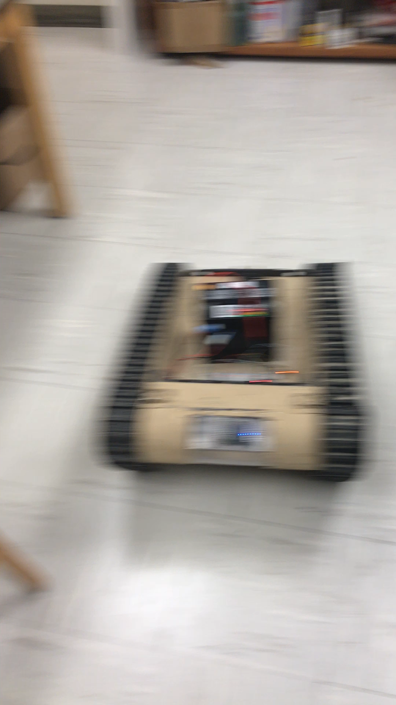
MAJOR PROJECT: MATILDA (Base)
Slack Channel: #projectmatildabase
Project lead: Ryan Moran
MATILDA stands for Mesa Associates' Tactical Integrated Light-Force Deployment Assembly
A bomb disposal robot from Dr. Roppel’s research lab.
Meeting Time:
Fridays 11:30 – 12:30
Semester Focus
Reestablishing mobility with wireless control
Establish autonomy with OpenCV
Potential add T-Shirt cannon to top
Github Repository
https://github.com/SPARC-Auburn/MATILDA-Base
Programming Languages
Python w/ OpenCV
C

Slide 16
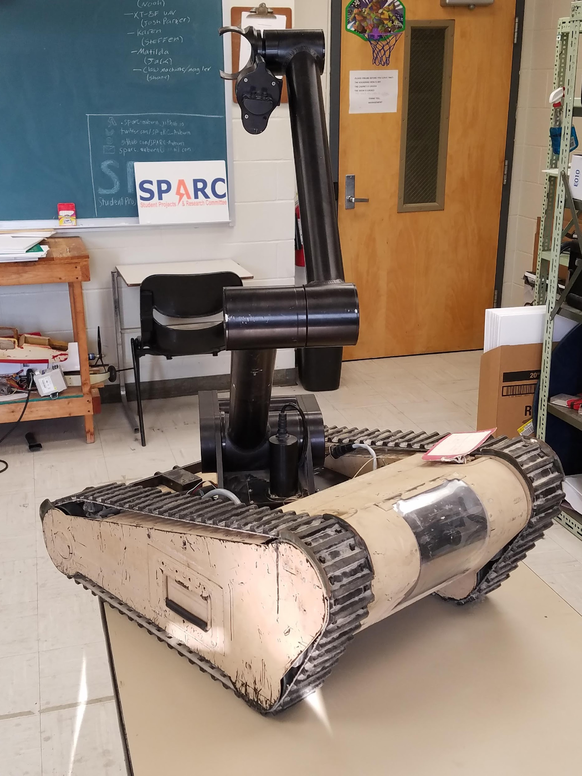
MAJOR PROJECT: MATILDA (Arm)
Slack Channel: #projectmatildarm
Project lead: Alex Jones/Rice Shelley
MATILDA stands for Mesa Associates' Tactical Integrated Light-Force Deployment Assembly
A bomb disposal robot from Dr. Roppel’s research lab.
Meeting Times:
Thursdays 12:30 - 2
Semester Focus
Reestablishing arm control
Develop arm to play chess
Github Repository:
https://github.com/SPARC-Auburn/MATILDA-Arm
Programming Languages
Python w/ OpenCV
C

Slide 17
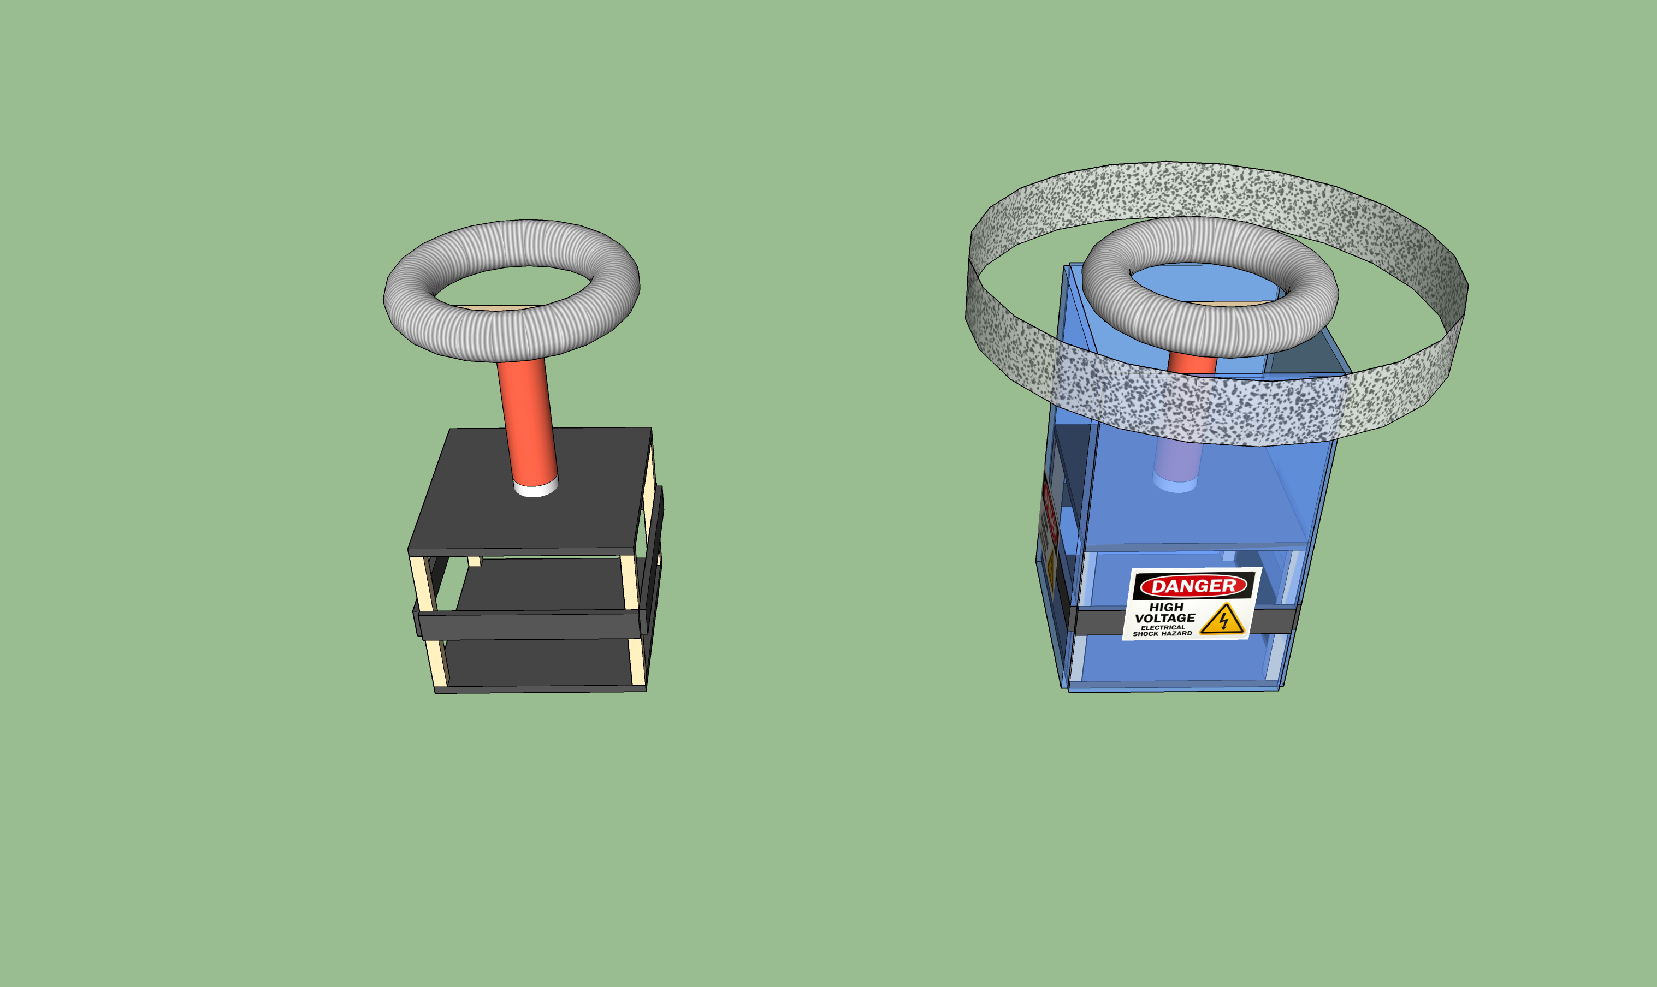
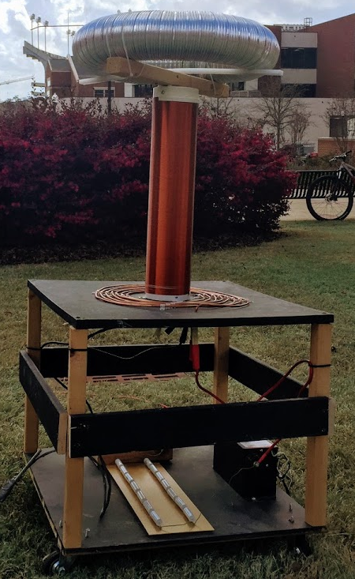
SIDE PROJECT: MUSICAL TESLA COIL
Project lead: Neil Postal
Slack Channel: #projectteslacoil
Demonstrated Tesla Coil at Spring 2016/18 E-Days
Currently uses spark gap style circuitry
Generated estimated 400,000 volts of electricity.
Semester Focus:
Increase safety precautions
Change from spark-gap design to solid-state design
Develop MIDI-input to allow music
Meeting times: Thursdays @ 3:30
Github: https://github.com/SPARC-Auburn/Tesla-Coil
Current Design
Possible safety precautions

Slide 18
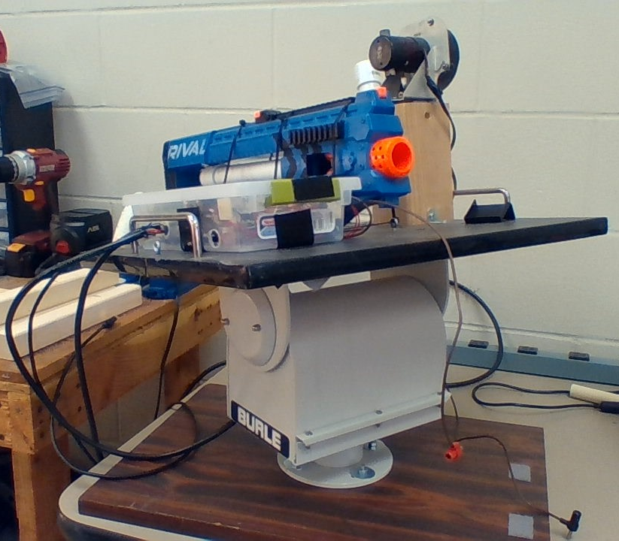
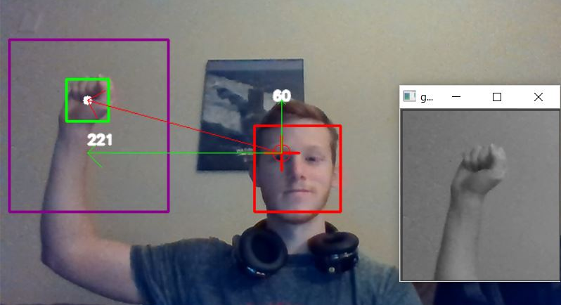
SIDE PROJECT: The Helpful Automated Defender (THAD)
Project lead: Josh Jablonowski
Slack Channel: #projectthad
Old project donated by EE department
It was demonstrated last spring at E-Day and PEAK.
Needs a new purpose to improve demonstrations
Github Repository:
https://github.com/SPARC-Auburn/THAD
Programming Languages
Python w/ OpenCV
C

Slide 19
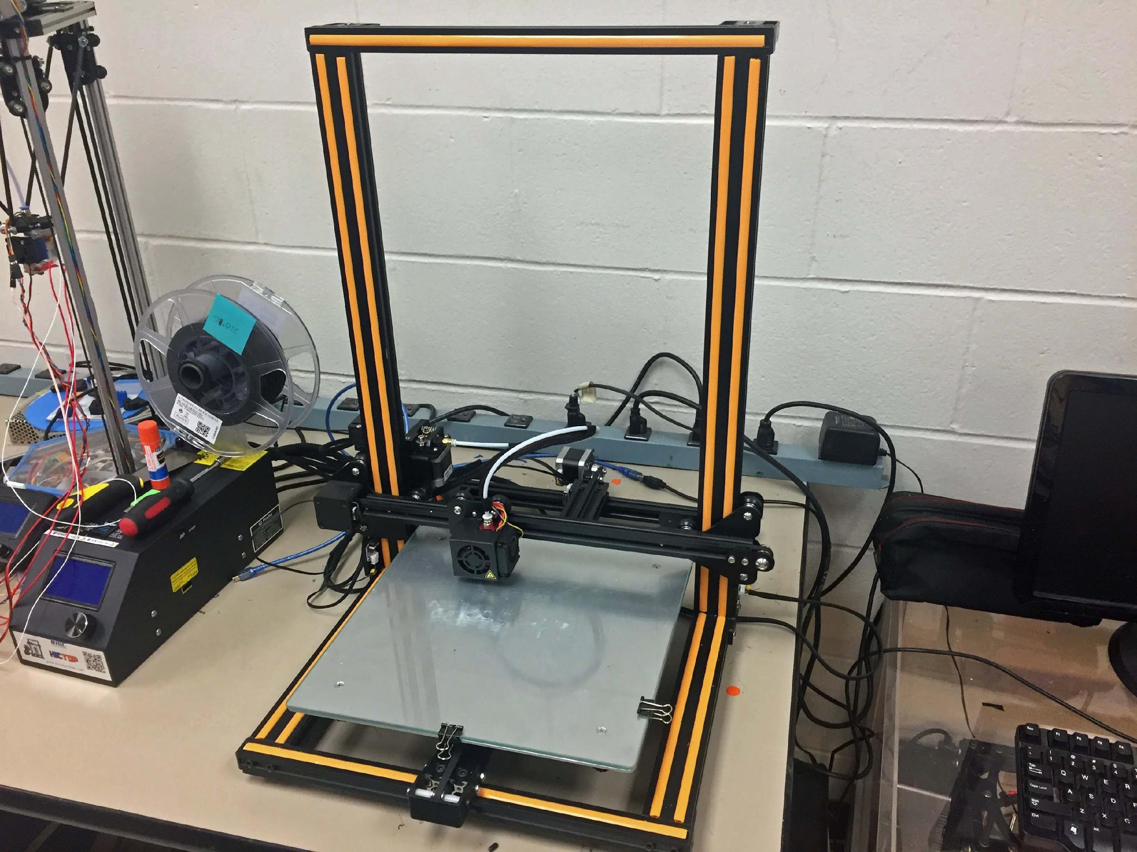
SIDE PROJECT: 3D PRINT ENCLOSURE
Project lead: Alex J. and Josh J.
Slack Channel: #3dprinting
Design double decker 3D printer enclosure to hold our Creality CR10 and Lulzbot Taz 3.
Will have wheels and have hinged doors
Will be a potential requirement based on new campus 3D printing rules.

Slide 20
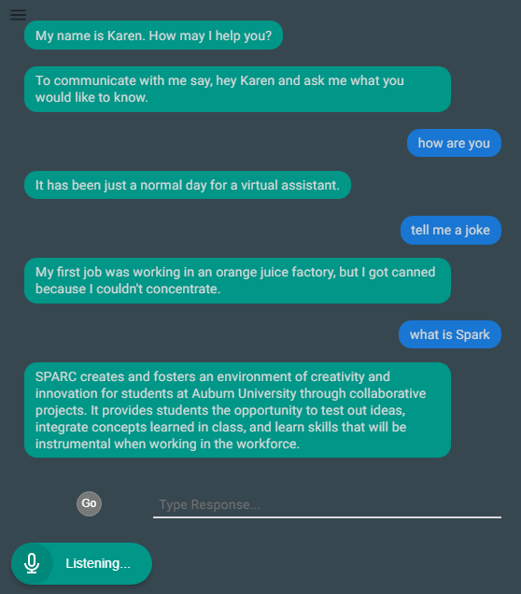
SIDE PROJECT: LAB ASSISTANT
Kinematic
Autonomous
Robot
Enriches
Newcomers
Lab
Information
Support
Tool
Project lead: Arthur Howard
Slack Channel: #projectlabassistant
Goal: create an automated lab assistant.
Is voice controlled.
One day will consist of both a stationary and mobile system.
Can be embedded on the new group chat system Slack.
Programmed in Node.JS (Framework of JavaScript)
Semester Focus
Add functionality
Add database for keeping track of members and equipment
Github Repository:
https://github.com/SPARC-Auburn/Lab-Assistant-IO
Programming Languages
Node.JS
Notes:
6:30

Slide 21
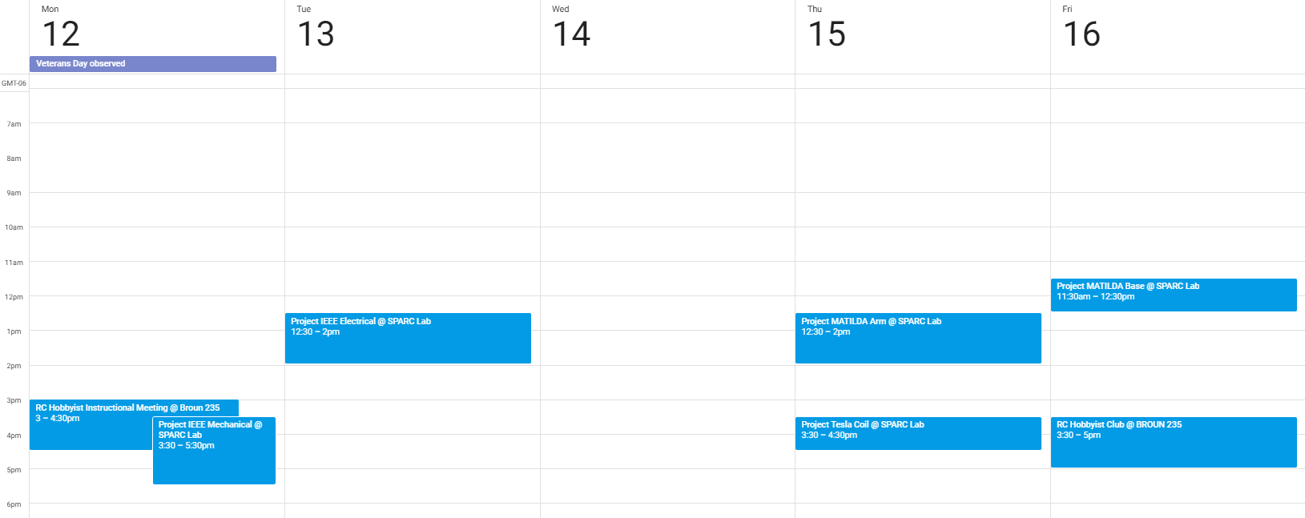
Meeting Schedule

Slide 22
PROJECT IDEAS?
email us at sparc.auburn@gmail.com
or DM Matthew Castleberry @mcberry23 via Slack

